Slide 1
Mars: Science and Engineering (Week 3)
Howard Seltman
CMU Osher
Fall 2023

Slide 2
Course Outline
Week 1
Astronomy background
Early flights with no or minimal success
Mariner Program
Week 2
1973: Soviet Mars program
1975: US Viking program
1990s: MGS, Pathfinder, Sojourner, Nozomi
Old issues: ATP, accumulated dust, radiation, airbags
Week 3
Early 2000s: Odyssey, Spirit & Opportunity, Mars Express
Late 2000s: Mars Reconnaissance Orbiter, Phoenix lander
Week 4
2010s: Curiosity, MAVEN, Mangalayan, Insight
2020s: Perseverance, Ingenuity, Tianwen, Emirati Hope
Mars science summary
Unlaunched: Exo-Mars
Humans?

Slide 4
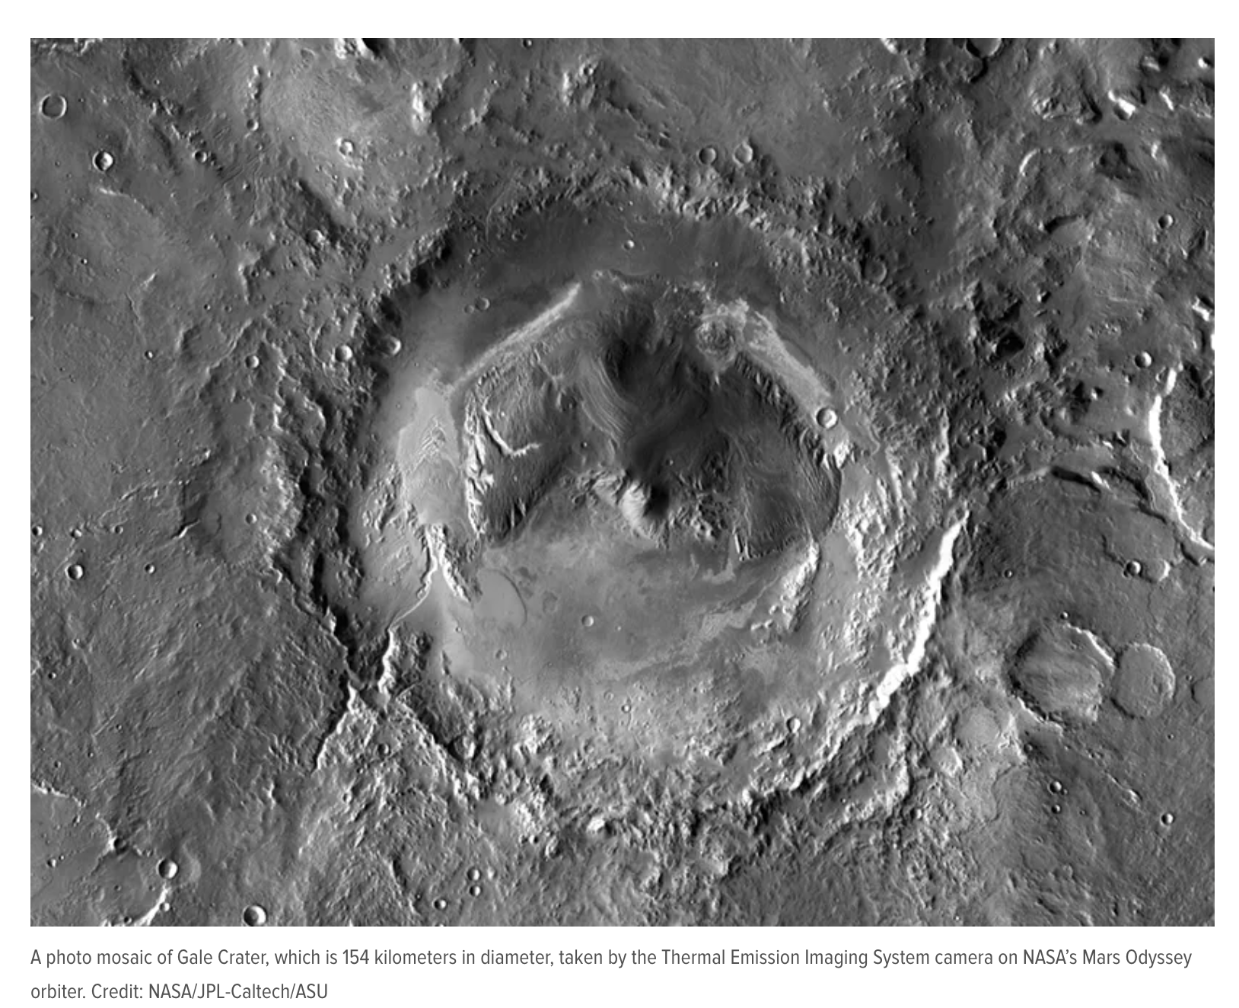
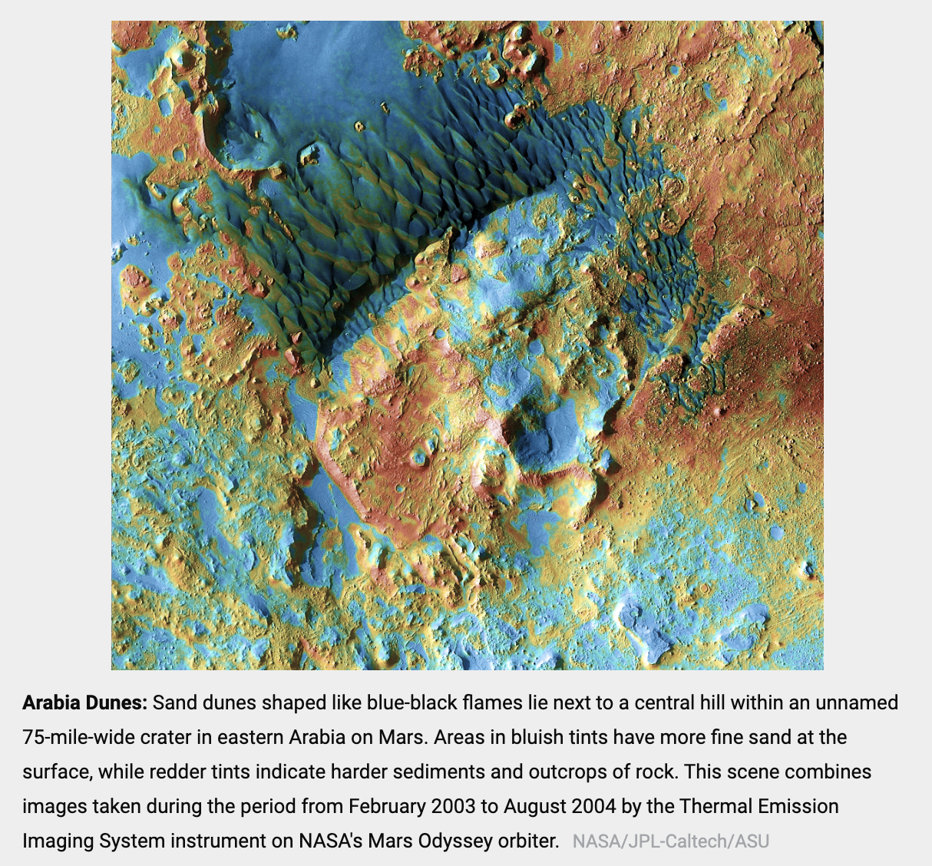
US Mars Odyssey
$300 million orbiter launched April 2001
In polar orbit since October 2001 and still operating
High resolution images, thermal imaging, and a radiation detector
Carries Russian High Energy Neutron Detector to see H of H₂0
Radio relay for Spirit and Opportunity

Slide 5
Digression: Challenges of Getting to Mars
Telecommunications (2:54)
Interplanetary Cruise (3:01)
Aerobraking (3:20)

Slide 6
Mars Odyssey: Results
First Infrared Images (1:54)
Results to date
Identified large amounts of hydrogen in the soil, implying the presence of water, much in the form of hydrated minerals, from 2% to 10% near the equator and up to 50% at some high latitudes (55ᴼ)
“Found evidence of salt deposits in 200 locations in southern Mars. These chloride minerals were left behind in places where water was once abundant”
“Observed the year-to-year variations in polar ice, clouds and dust storms”
“Helped select a landing site for the Mars Science Laboratory (MSL) and it later acted as a relay for the MSL rover Curiosity”
“Mars Odyssey’s camera had helped construct the most accurate global map of Mars ever, using 21,000 images from the THEMIS instrument. These pictures have been smoothed, matched, blended, and cartographically controlled to make a giant mosaic available to users online”

Slide 7
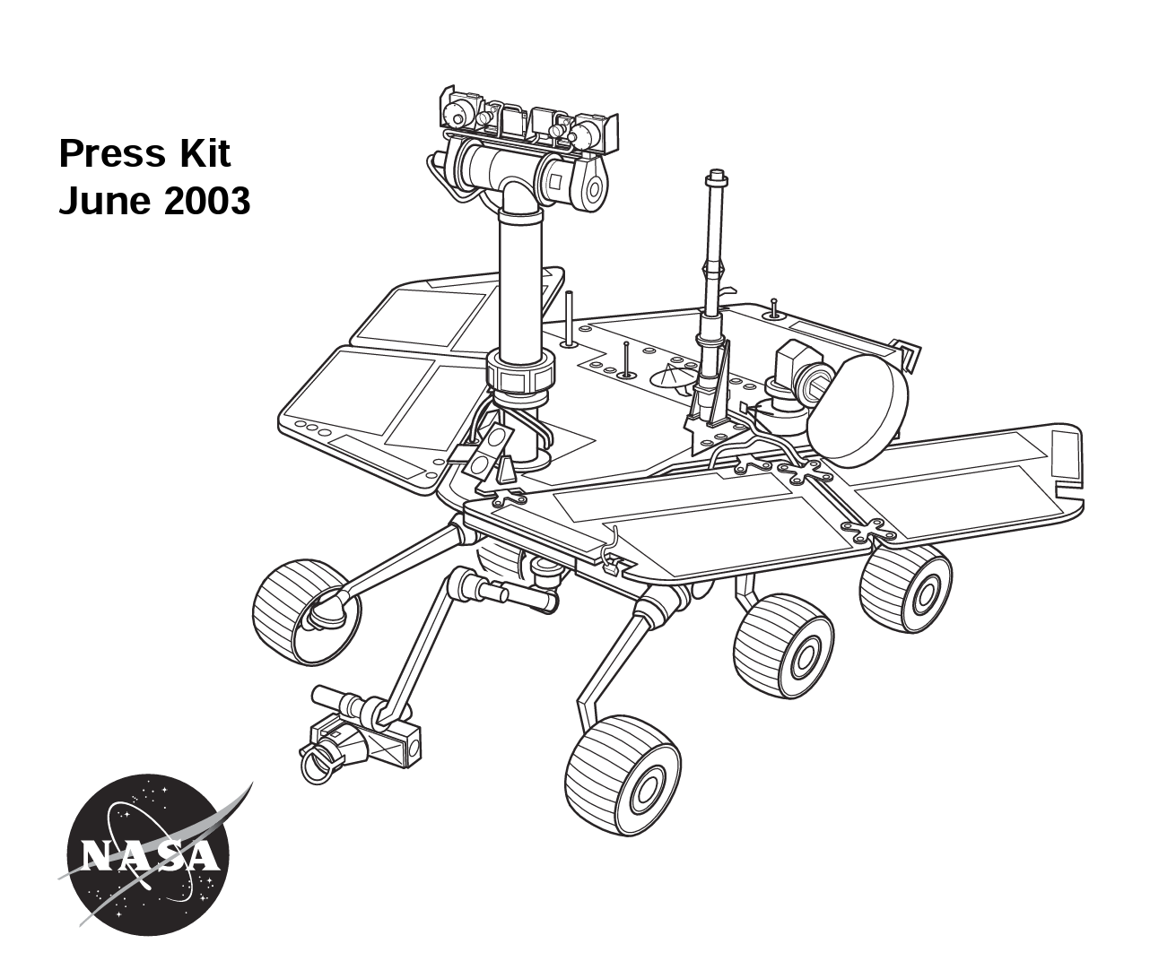
US Mars Exploration Rovers [MERs]
Spirit and Opportunity “robotic geologists” that arrived January 2004
Sharper images, further travel, first microscopic views of rocks
Communication via Mars Odyssey
Lander base without instrumentation
EDL with airbags

Slide 8
MER Science Plan
Chief Scientist: Steve Squyres of Cornell University
EDL Lead: Adam Steltzner (NASA’s “rock star” engineer)
Panoramic camera at human height and thermal emission spectrometer used to help scientists on Earth to identify target sites
Rover goes to the site, avoiding hazards on its own
Microscopic imager sends back hand-lens equivalent images
Spectrometers identify composition
Mössbauer spectrometer: measures nuclear recoil of gamma rays (Co-57, half life 272 days, 300mCi) to identify and quantify iron-containing minerals
Alpha Particle X-Ray Spectrometer (APXS): determines elemental composition of rocks via response to alpha particle bombardment
Rock abrasion tool (RAT) substitutes for the geologist’s hammer, scraping away the weathered surface
Scraped rock is re-analyzed by spectrometers

Slide 9
Spirit and Opportunity Development
JPL Mission To Mars Documentary (13:45)
NASA seamstresses
Airbag testing
Review board
Science vs. engineering for choosing the landing site
Parachute testing
Integration and testing
Retrorocket testing
Field Integrated Design and Operation
Parachute testing after design changes

Slide 10
Digression: Choosing a Landing Site
Choosing A Landing Site (0:59)

Slide 11
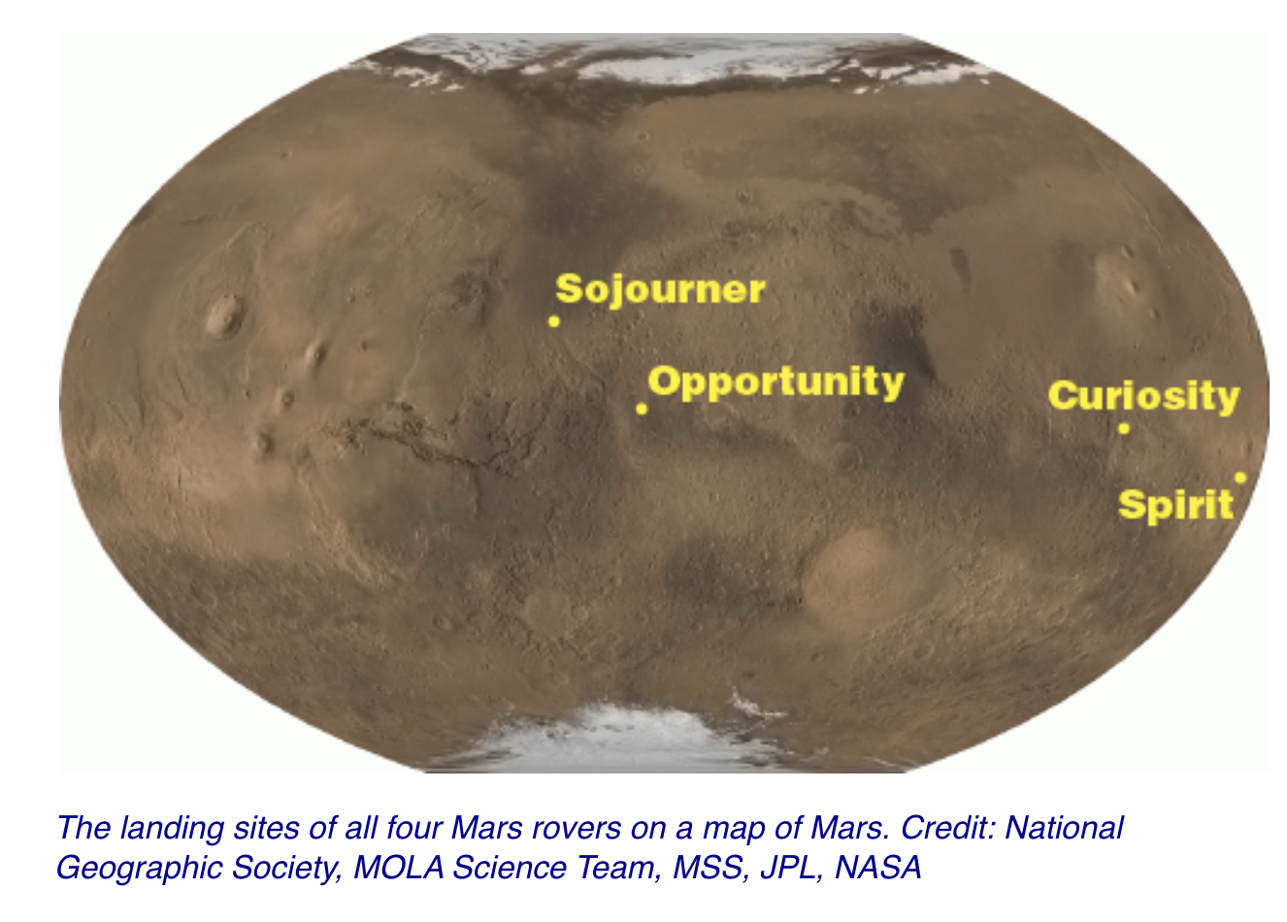
MER landing sites
Spirit (MER-A) proposed landing site: Gusev Crater, possible former lake in giant impact crater
Opportunity (MER-B) proposed landing site: Meridiani Planum, where mineral deposits suggest wet past

Slide 12
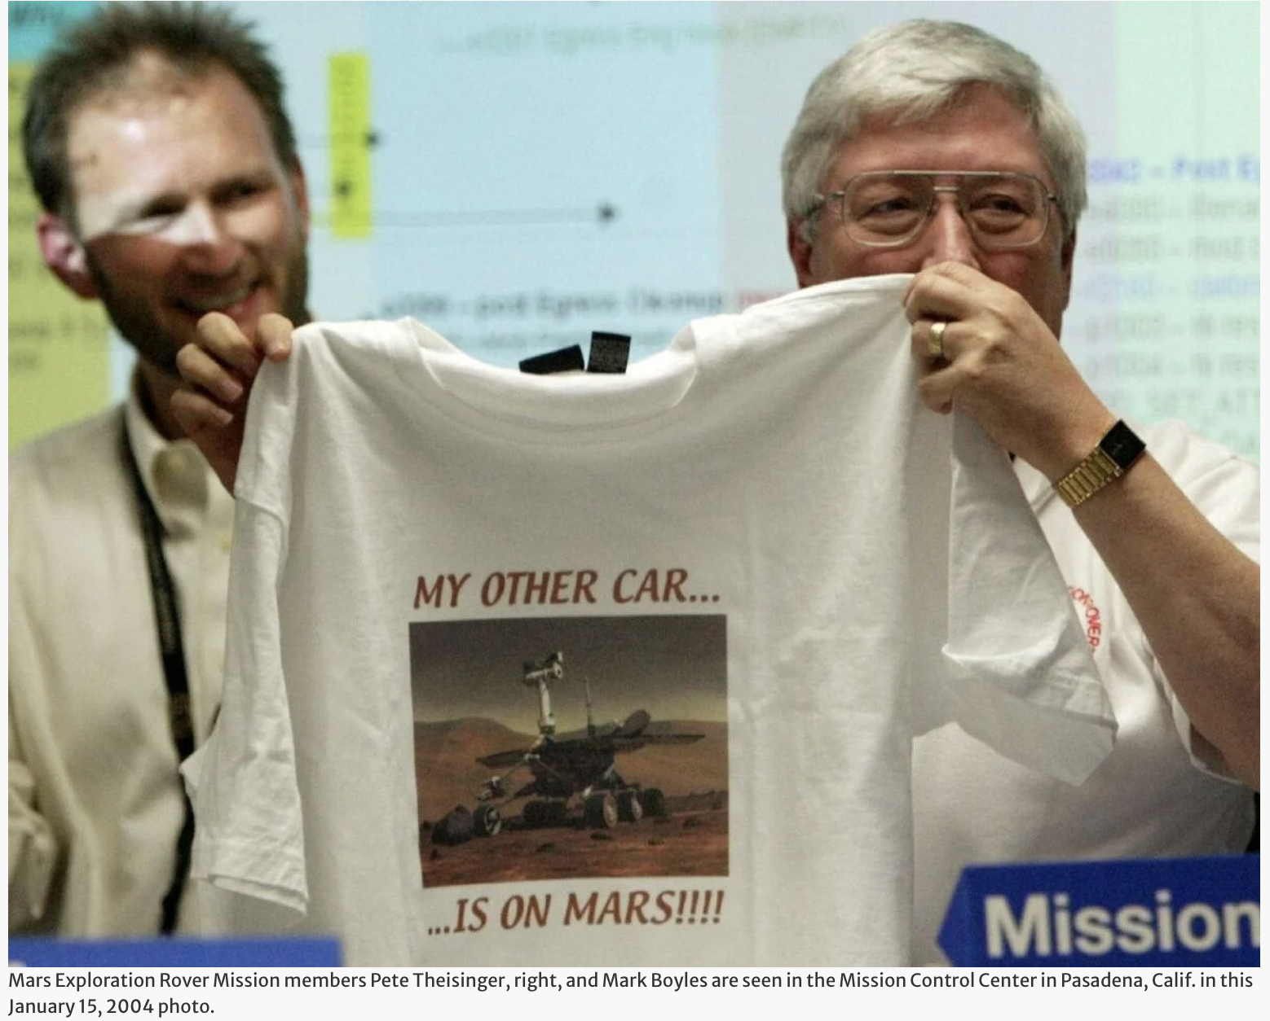
Spirit’s ”Six Minutes of Terror” (Jan. 3, 2004)
Spirit Six Minutes of Terror (5:59)
Opportunity landing (at higher altitude) also successful after adjustments made based on Spirit descent data

Slide 13
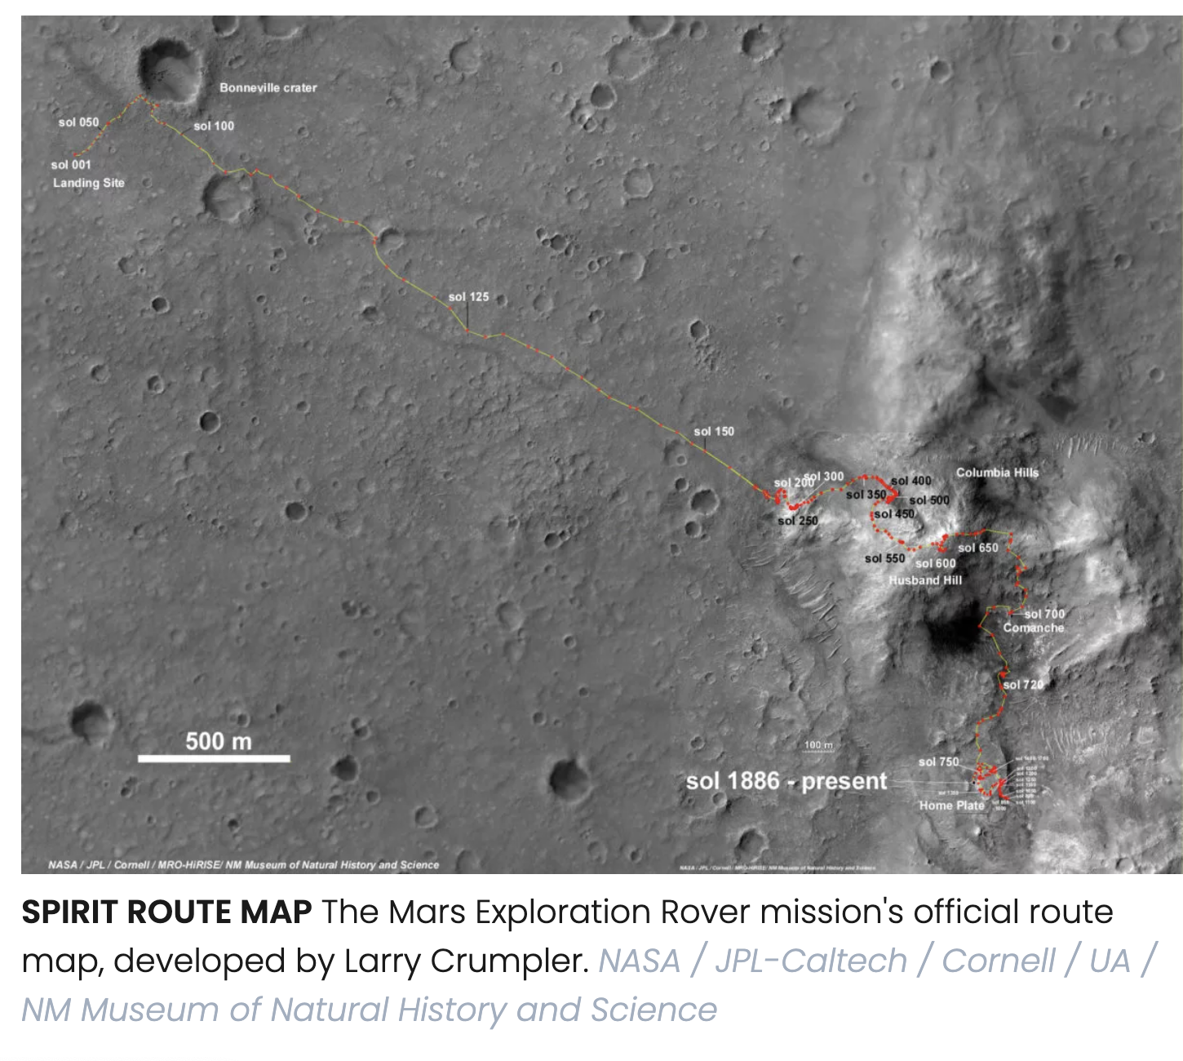
Spirit operations and findings
Lander protective shell holds rover with 126 cables and can turn the rover upright and provide a ramp for rover exit
Six years and 5 miles: NASA Spirit's Triumph (4:36)

Slide 14
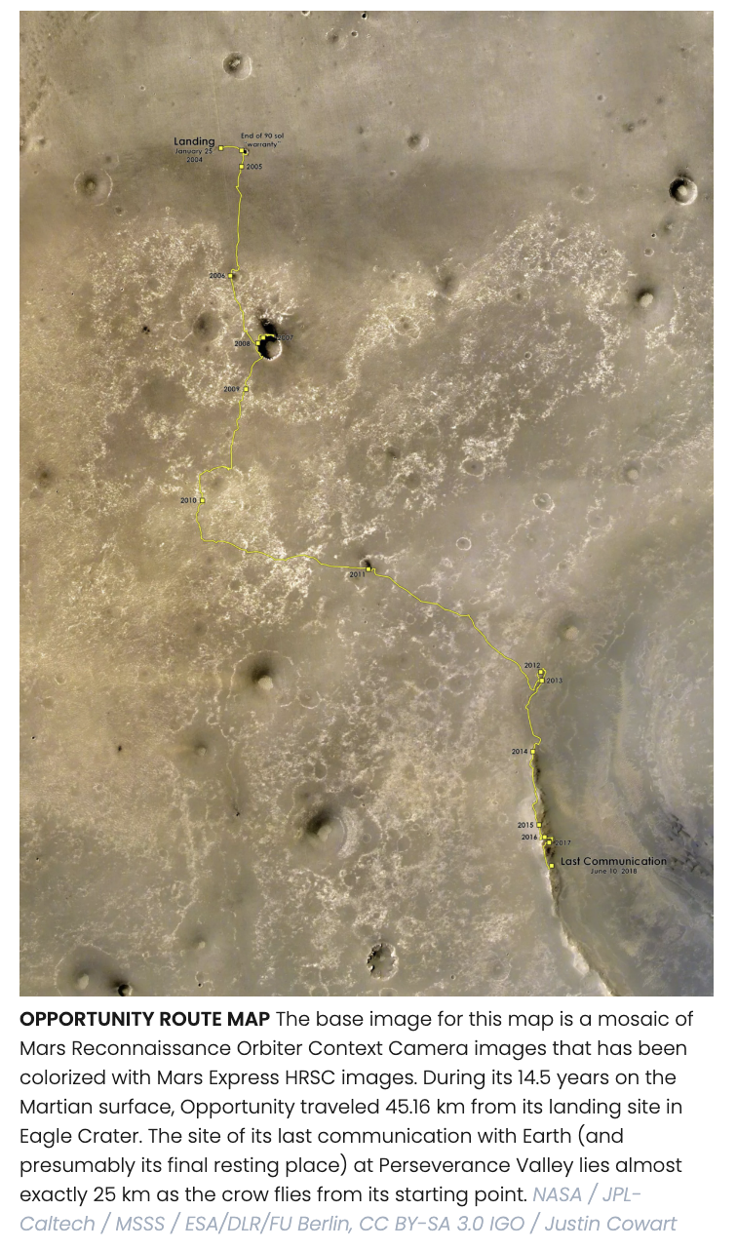
Opportunity operations and findings
15 years and 28 miles
Opportunity summary (3:34)

Slide 15
ESA Mars Express Orbiter and Beagle Lander
2003 Mars Express Orbiter and Beagle lander were built by Astrium, an aerospace company based in Paris with employees also in Germany, UK, Spain, and the Netherlands
Operated out of ESA Operations Centre in Darmstadt, Germany
Launched from Baikonur on a Soyez/Fregat rocket

Slide 16
Mars Express Instruments
Visible and Infrared Mineralogical Mapping Spectrometer (France): Determines mineral composition of the surface up to 100 m resolution
Ultraviolet and Infrared Atmospheric Spectrometer (France): Assesses elemental composition of the atmosphere
Sub-Surface Sounding Radar Altimeter (Italy): A radar altimeter used to assess composition of sub-surface aimed at search for frozen water
Planetary Fourier Spectrometer (Italy): Makes observations of atmospheric temperature and pressure
Analyzer of Space Plasmas and Energetic Atoms (Sweden): Investigates interactions between upper atmosphere and solar wind
High Resolution Stereo Camera (Germany): Produces color images with up to 2 m resolution
Mars Express Lander Communications (UK): Allows Mars Express to act as a communication relay for landers on the Martian surface
Visual Monitoring Camera, a small camera to monitor the lander release

Slide 17
Beagle Lander
British built
Named after Darwin’s ship
Focus on habitability and detection of organic chemicals
Robotic arm known as the Payload Adjustable Workbench (PAW) contained a pair of stereoscopic cameras, a microscope with a 6-micrometre resolution, a Mössbauer spectrometer, an X-ray spectrometer, a drill for collecting rock samples and a spot lamp
The PAW could transfer samples to GC/MS to measure isotope ratios of carbon and methane
Also had a burrowing tool to get deeper samples
Deployed December 25, 2003, with no confirmation of a successful landing
Fate unknown until 2015 when MRO photographed the remains and found that solar panels only partially deployed, and the antenna remained covered

Slide 18
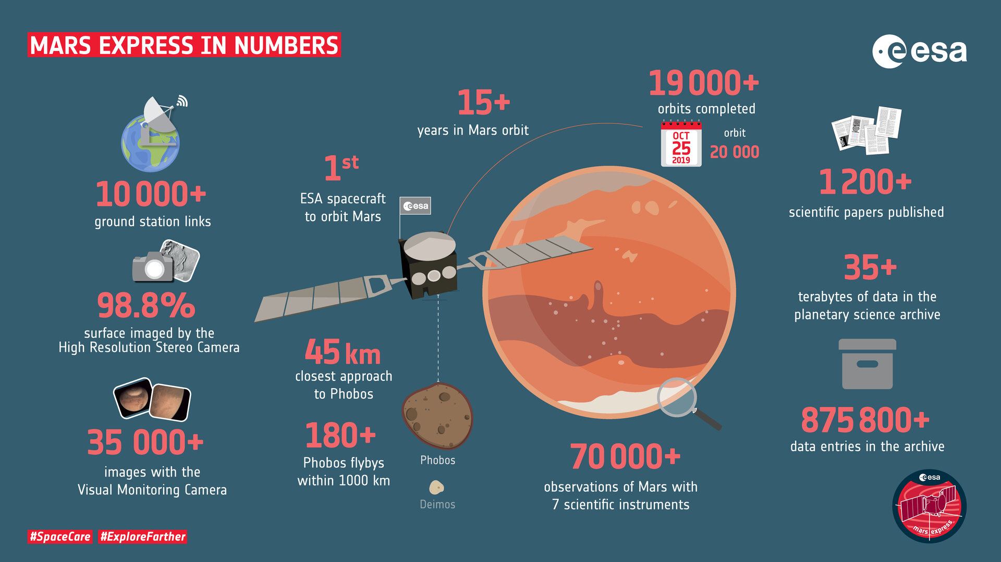
Mars Express Summary
ESA Documentary (3:13)

Slide 19
Mars Express Scientific Findings
Producing global maps tracing the planet’s geologic activity, water, volcanism and minerals
Studying immense volcanoes, canyons, polar ice caps, and ancient impact craters.
Probing the sub-surface with radar, detecting subsurface layers of water ice and liquid water hidden under the planet's south pole
Explored the Martian atmosphere, finding signs of ozone and methane, fleeting cloud layers up to 100 km above Mars' surface, and mighty dust storms
Witnessing charged particles escaping to space
Finding the first evidence of a planet-wide groundwater system where interconnected underground lakes may contain minerals crucial to life
Examining Mars’ moons Phobos and Deimos, with the revised mass and density data opening the possibility that the interior of Phobos resembles a porous sponge
Identifying dried-up river valleys, traces of catastrophic floods, and buried glaciers
Discovering localized auroras on Mars
Measuring the quantity and composition of ice at the polar regions, finding that there is enough water ice in the south polar cap to create a global ocean 11-metres deep
Detecting volcanic activity as recently as 100 million years ago, leading to speculation that some volcanoes may still be active today

Slide 20
US Mars Reconnaissance Orbiter
Launch August 2005
Arrival March 2006, still working
$500 million to build and launch, $30 million per year to operate
Goals: Investigate history of water on Mars
Instrumentation
Hi-res cameras (1 foot resolution)
Spectrometers
Shallow Subsurface Radar (Italian Space Agency) to probe the internal structure of the Martian polar ice caps
As of July 2023, returned 450 terabytes of data
Looking for
Deposits of minerals that may have formed in water over long periods of time
Evidence of shorelines of ancient seas and lakes
Deposits placed in layers over time by flowing water.
Evidence of whether underground Martian ice seen by Odyssey is the top layer of a deep ice deposit or a shallow layer in equilibrium with the atmosphere and its seasonal cycle of water vapor

Slide 21
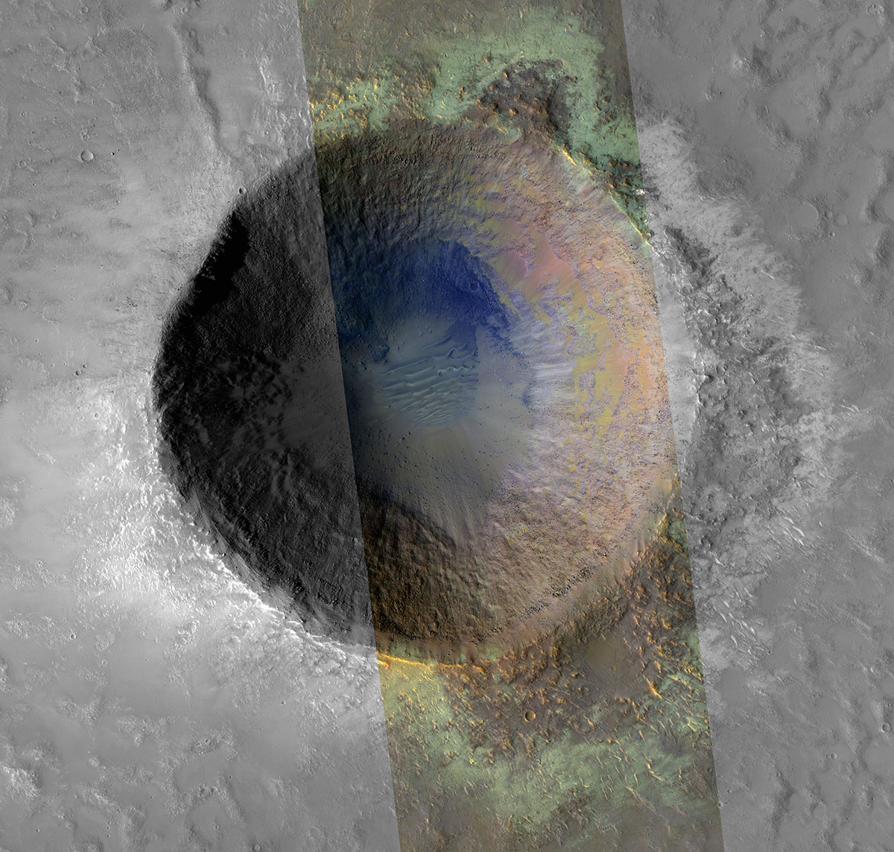
MRO Results
"tie mineral deposits observed in high-resolution images to regional scale trends, landscape features, and geology”
Mostly iron oxides, silicates, chlorides, and carbonates

Slide 22
MRO Results
More recently created craters show excavated water ice, which gradually sublimes
Piles of rock debris below cliffs also show large amounts of water ice with a strong suggestion that these may be analogous to glaciers on Earth
Widespread chloride deposits are thought to be due to evaporation of mineral-rich waters, suggesting prior lakes
Several types of clay were found
Originally suggested that “recurring slope lineae” were caused by current flowing salt water, but these were later shown to be created by grains of sand and dust
Confirmed the presence of subsurface water ice up to a depth of 29 inches at latitudes between 40° and 60° N

Slide 23
US Phoenix Lander
First NASA mission led by a public university (U of Arizona) in cooperation with JPL and partners in Canada, Switzerland, Denmark, Germany, Finland and the UK
Used copies of instruments from failed prior missions
First to land in the polar region (68ᴼ North)
Not a rover because the landing area is uniform, and more weight budget could be used for instrumentation
Built by Lockheed Martin for $325 million (plus $95 million to launch)
Launched August 2007, landed May 2008
Planned to operate for 90 sols, operated for 157 sols
Objectives
Dig through topsoil to study the chemistry of ice below
Look for organics at a depth protected from radiation
Also contained a DVD similar to the Voyager “golden record”

Slide 24
Phoenix Lander Instrumentation and Overview
Robotic arm can dig 7.5 feet out and 1.5 feet deep using a rotating rasp tool
Thermal and Evolved Gas Analyzer (TEGA) heats the samples and feed the gasses released to a mass spectrometer
Microscopy, Electrochemistry and Conductivity Analyzer (MECA) does microscopic analysis of soil to determine mineralogy, and measures water and ice content, salinity and acidity
Meteorology Station records daily weather with temperature, pressure and LIDAR to detect dust, clouds and fog
No organic compounds were detected by the GC-MS, possibly due to destruction by perchlorates
Overview video (2:30)
PBS Documentary (1:22)

Slide 25
Summary of Week 3
Odyssey is an example of a very long-lived orbiter
Spirit and Opportunity rovers performed superbly
ESA’s first Mars mission was a big success, but UK’s Beagle failed
US MRO returned unprecedented amounts of data
US successfully carried out the first high latitude mission (Phoenix) and sampled water ice for the first time

Slide 26
What’s next
2010s: Curiosity, MAVEN, Mangalayan, Insight
2020s: Perseverance, Ingenuity, Tianwen, Emirati Hope
Mars science summary
Unlaunched: Exo-Mars
Humans?

